Slide 1
Dependency Parsing
Introduction
Notes:
Ready to record!

Slide 2
Dependency Grammar and Dependency Structure
Dependency syntax postulates that syntactic structure consists of lexical items linked by binary asymmetric relations (“arrows”) called dependencies
submitted
nsubjpass
auxpass
prep
The arrows are commonly typed with the name of grammatical relations (subject, prepositional object, apposition, etc.)
Bills
were
by
prep
pobj
on
Brownback
pobj
nn
appos
ports
Senator
Republican
cc
conj
prep
and
immigration
of
pobj
Kansas

Slide 3
Dependency Grammar and Dependency Structure
Dependency syntax postulates that syntactic structure consists of lexical items linked by binary asymmetric relations (“arrows”) called dependencies
submitted
The arrow connects a head (governor, superior, regent) with a dependent (modifier, inferior, subordinate)
Usually, dependencies form a tree (connected, acyclic, single-head)
nsubjpass
auxpass
prep
Bills
were
by
prep
pobj
on
Brownback
pobj
nn
appos
ports
Senator
Republican
cc
conj
prep
and
immigration
of
pobj
Kansas
Notes:
The arrows may be drawn in either direction.
If tree height is used to show governor, then you don’t need arrows at all.
Mention ROOT and draw it in.

Slide 4
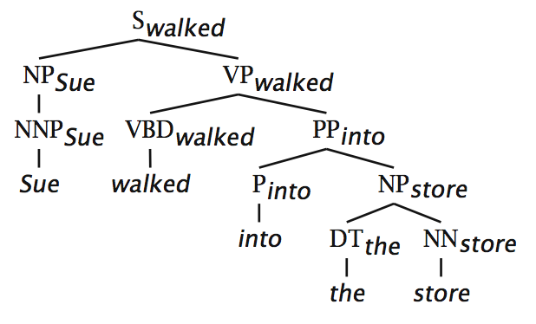
Relation between phrase structure and dependency structure
A dependency grammar has a notion of a head. Officially, CFGs don’t.
But modern linguistic theory and all modern statistical parsers (Charniak, Collins, Stanford, …) do, via hand-written phrasal “head rules”:
The head of a Noun Phrase is a noun/number/adj/…
The head of a Verb Phrase is a verb/modal/….
The head rules can be used to extract a dependency parse from a CFG parse
The closure of dependencies give constituency from a dependency tree
But the dependents of a word must be at the same level (i.e., “flat”) – there can be no VP!

Slide 5
Methods of Dependency Parsing
Dynamic programming (like in the CKY algorithm)
You can do it similarly to lexicalized PCFG parsing: an O(n⁵) algorithm
Eisner (1996) gives a clever algorithm that reduces the complexity to O(n³), by producing parse items with heads at the ends rather than in the middle
Graph algorithms
You create a Maximum Spanning Tree for a sentence
McDonald et al.’s (2005) MSTParser scores dependencies independently using a ML classifier (he uses MIRA, for online learning, but it could be MaxEnt)
Constraint Satisfaction
Edges are eliminated that don’t satisfy hard constraints. Karlsson (1990), etc.
“Deterministic parsing”
Greedy choice of attachments guided by machine learning classifiers
MaltParser (Nivre et al. 2008) – discussed in the next segment

Slide 6
Dependency Conditioning Preferences
What are the sources of information for dependency parsing?
Bilexical affinities [issues → the] is plausible
Dependency distance mostly with nearby words
Intervening material
Dependencies rarely span intervening verbs or punctuation
Valency of heads
How many dependents on which side are usual for a head?
ROOT Discussion of the outstanding issues was completed .
Notes:
Add a ROOT or WALL at one end, and then every word is the dependent of one word in the sentence

Slide 7
Dependency Parsing
Introduction

